Slide 1
Creating a Learning Network
Stephen Downes
ABED – Curitiba, Brazil
October 7, 2014

Slide 2
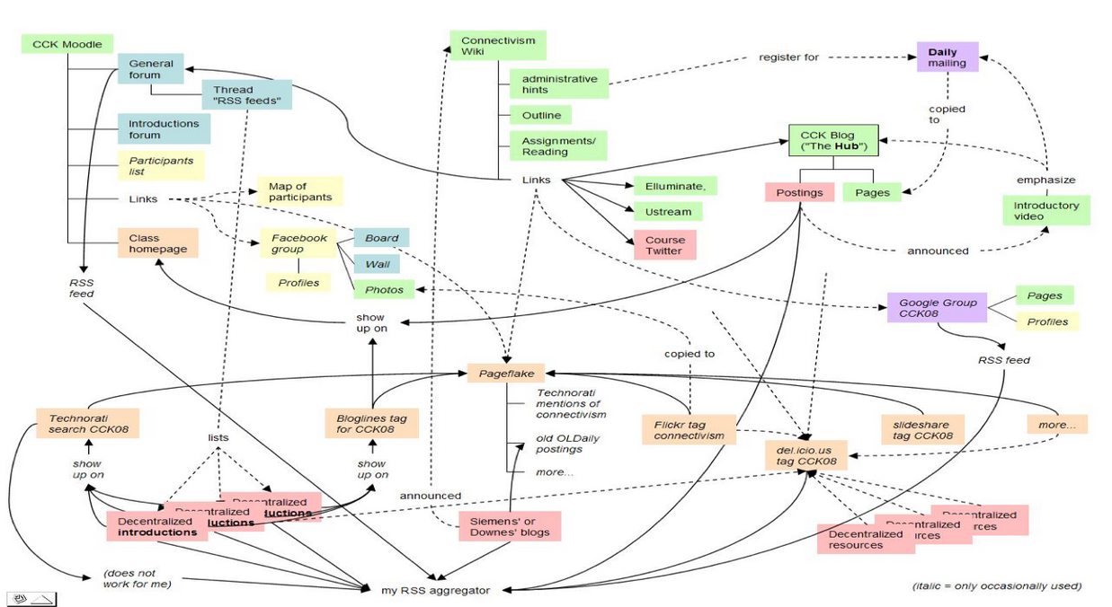
We built a MOOC…

Slide 3

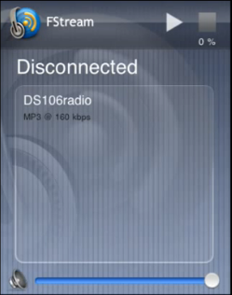
DS106 – Grant Potter
http://ds106.us/ds106-radio/

Slide 4
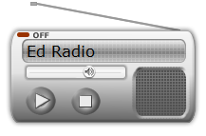
How I Built Ed Radio

Slide 6
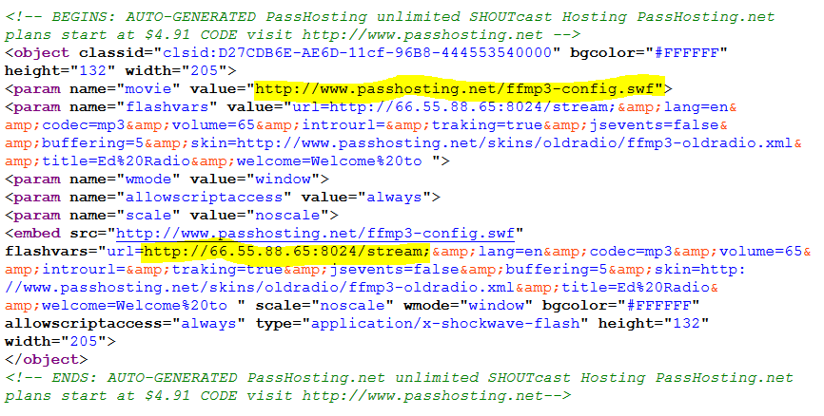

Slide 7


Flash
HTML5
.pls

Slide 8
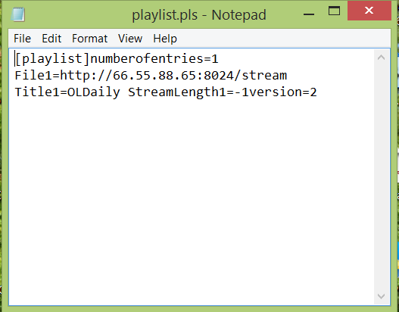
.pls file – points to streaming source

Slide 9
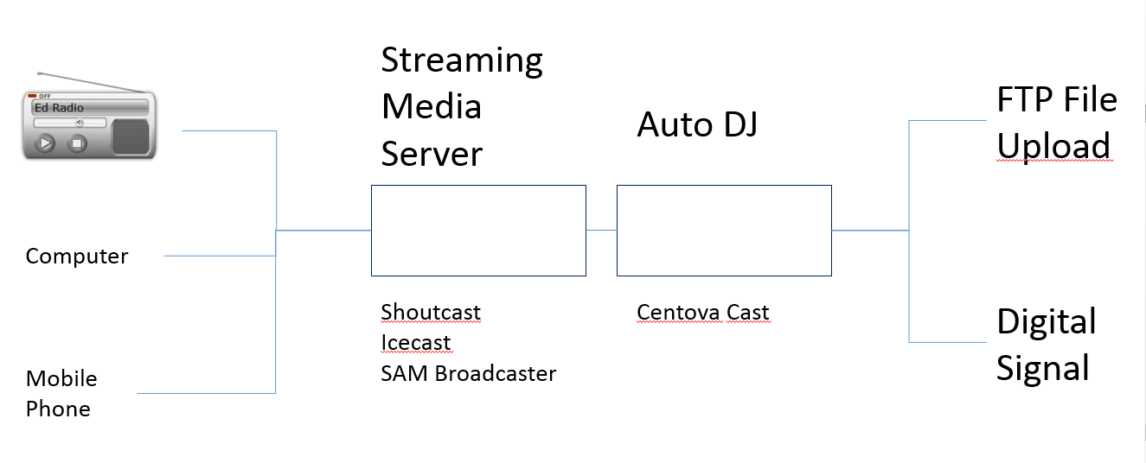

Slide 10
Streaming Media Server
FTP File Upload
Auto DJ
Computer
Shoutcast
Icecast
SAM Broadcaster
Centova Cast
Digital Signal
Mobile Phone

Slide 11

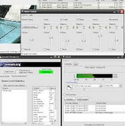

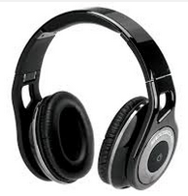
Digital Signal
Edcast, Nicecast
Files
Or Mixxx
Digital Signal
Processor
Playlist
Mic
Media Player
Stereo Mix
Speakers Headphones

Slide 12
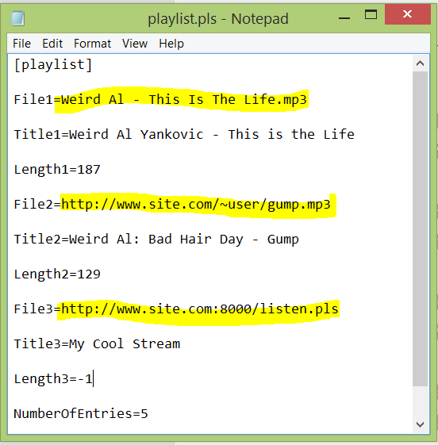
Local file
Web file
Streaming source
Web fil
.pls file – points to mp3 files online

Slide 13
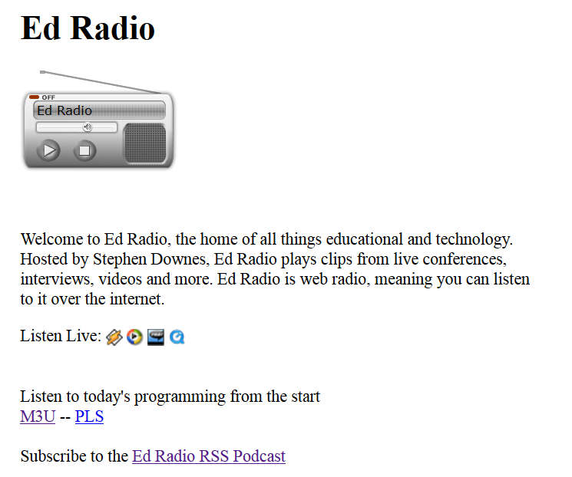
Stream
.pls File
RSS

Slide 14
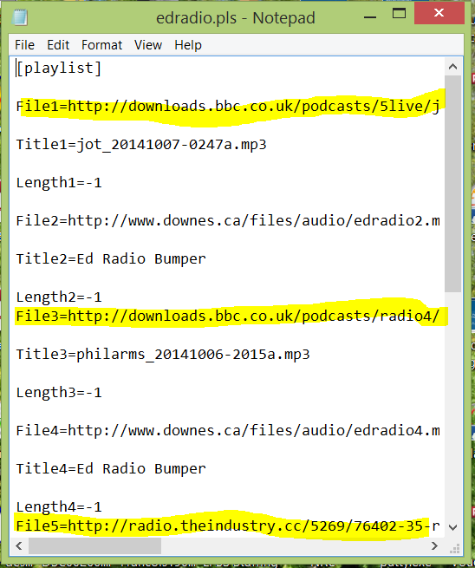
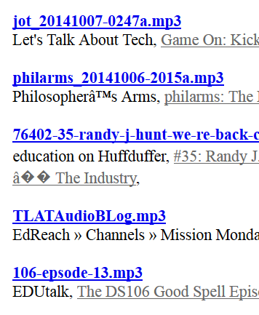

Slide 15
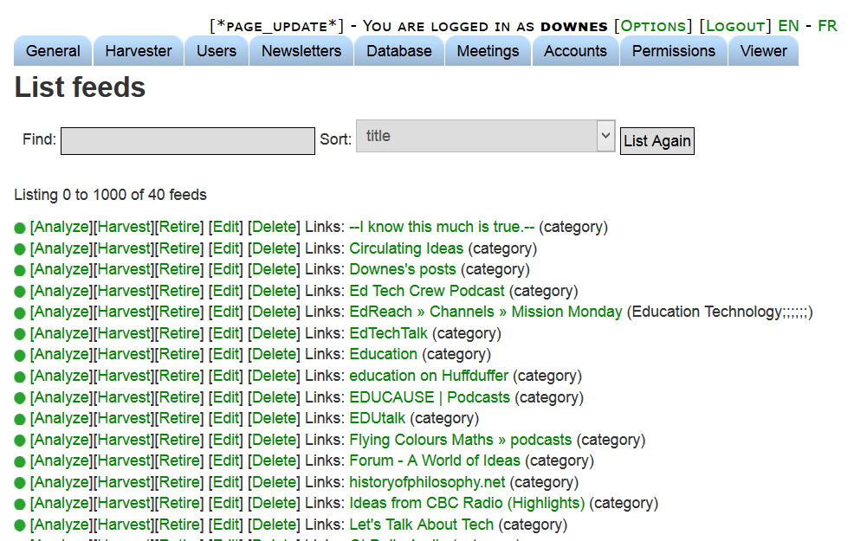

MP3 files RSS Feeds

Slide 16
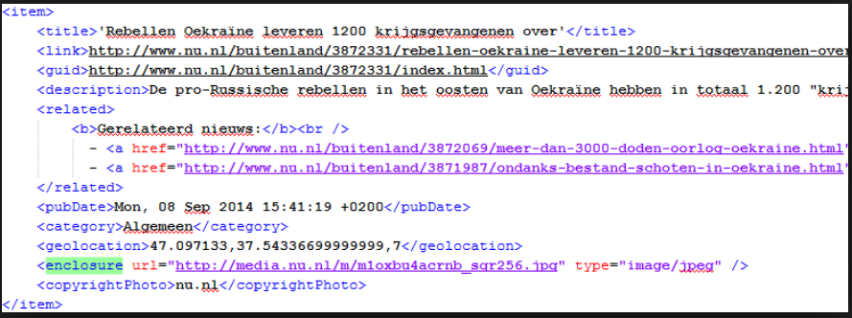
Enclosures in RSS Files indicate MP3 sources

Slide 17

Sources include RSS, Twitter, Facebook APIs, etc.

Slide 18
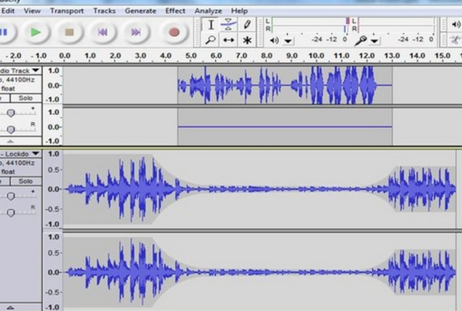
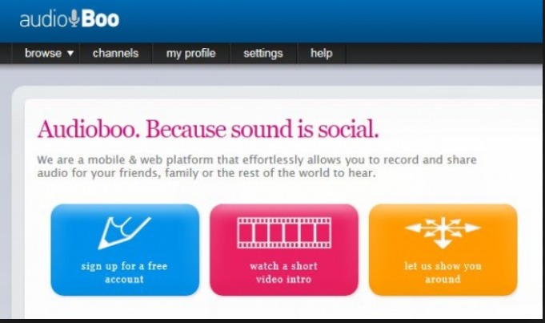
Audioboo
Audacity
Create MP3 files and upload them to the web

Slide 19
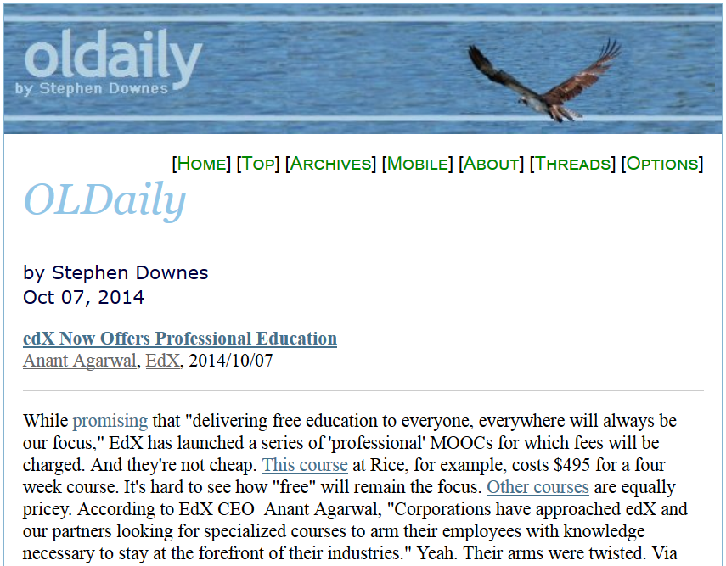
How I Built OLDaily

Slide 20
Web page
Email newsletter
RSS feed
Twitter @OLDaily
OLDaily
Newsletter

Slide 21
Web
commentary
Email
Posts
Links
RSS
Title
URL
Feed
Author
Twitter
OLDaily

Slide 22
RSS Reader
Links
Email
Social Net

Slide 23
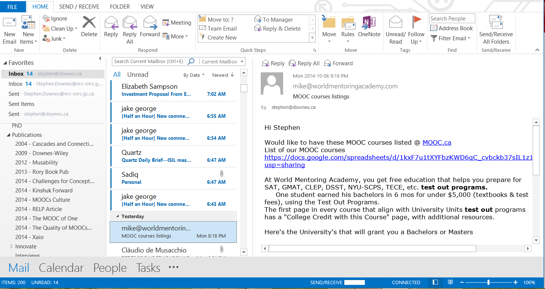
Email
Google groups
Mailing Lists
Subscriptions
Alerts

Slide 24
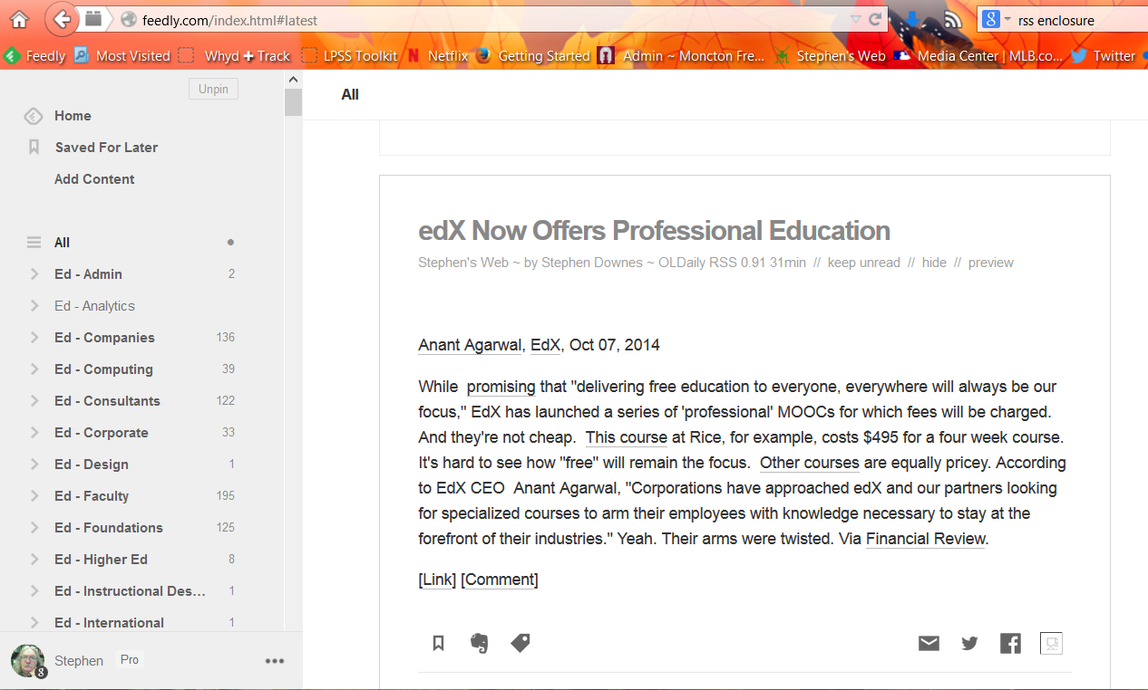
RSS
Feedly
Old Reader
Outlook

Slide 25
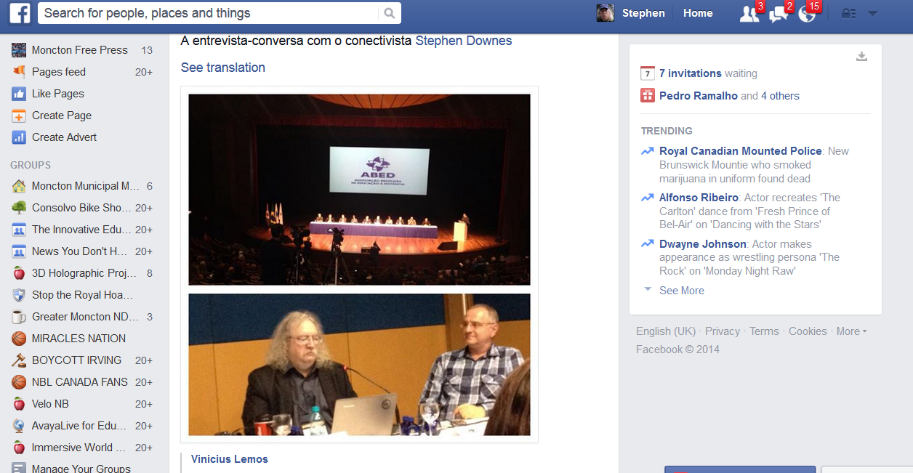
Twitter
Facebook
Google+
LinkedIn
Social Media
Groups
Channels
Hashtags

Slide 26
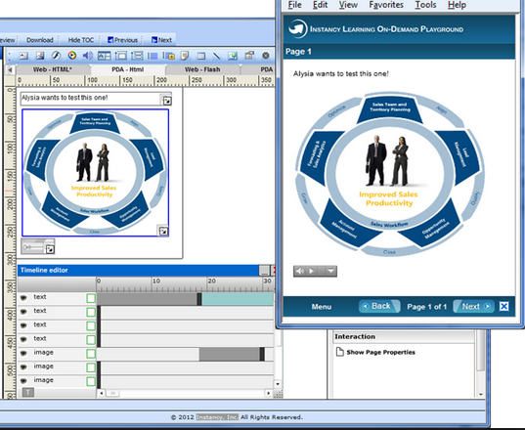
Content Sources
  Blogger / Wordpress
  Content management system
  Social media
  Discussion groups

Slide 27
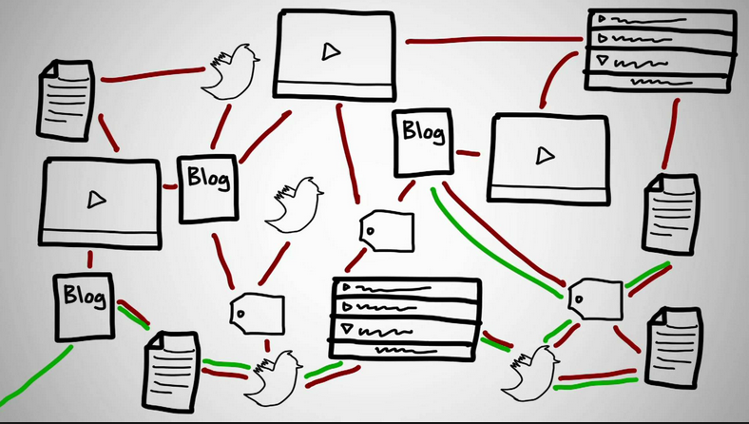
How I Built a MOOC

Slide 28
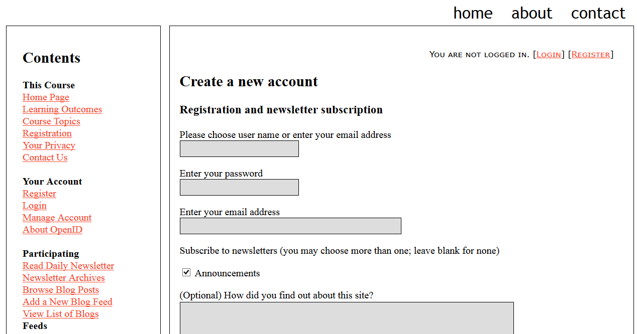
Notification – url - sign up for newsletter

Slide 29
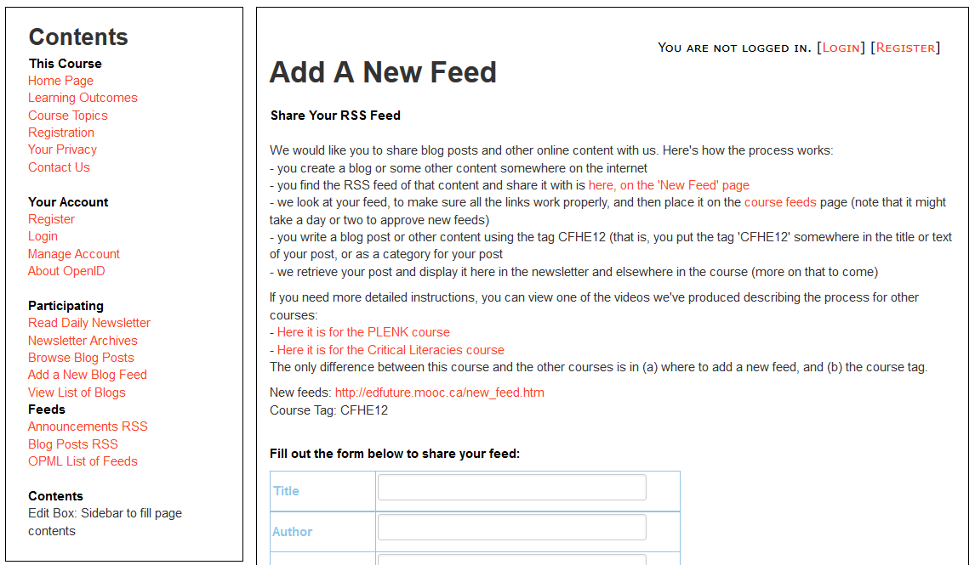
Add a New Feed

Slide 30
Posts & Articles
Blogger - Wordpress
Posts & Tweets
Hashtags
MOOC
Participants
Groups
Google, Yahoo Groups
Channels
YouTube, Flickr, Soundcloud

Slide 31
Posts & Articles
Blogger - Wordpress
Posts & Tweets
Hashtags
Web
Links
Email
Groups
Google, Yahoo Groups
Posts
RSS
Channels
YouTube, Flickr, Soundcloud
Twitter

Slide 32
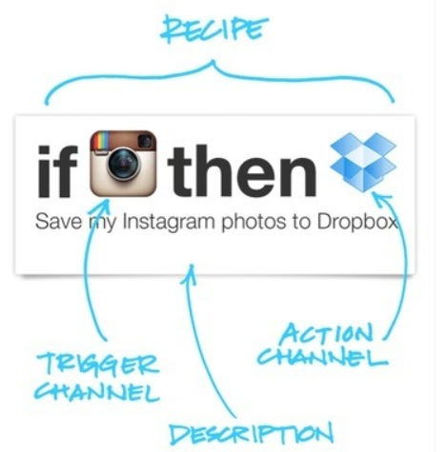
RSS content
  Feed list
    Submit feed - RSS
      Blog, twitter, group, etc.
    Sign up account API
    Relays
      Yahoo Pipes
      IFTTT
      Hootsuite
      Evernote

Slide 33
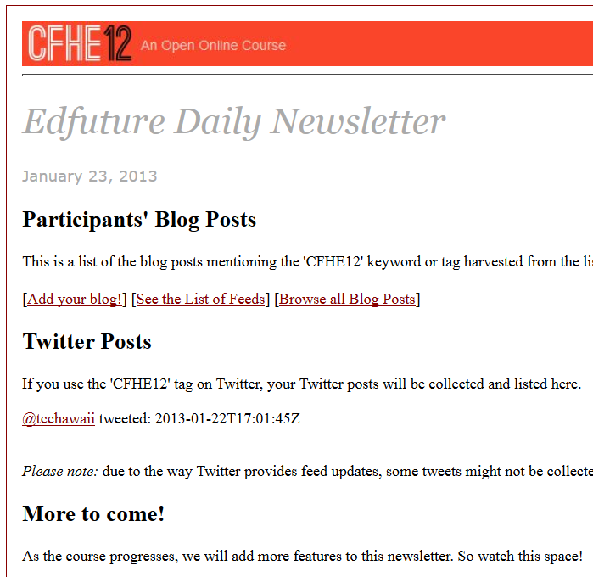
Daily news
  Announcements
  Calendar of events
  Posts
  RSS content

Slide 34
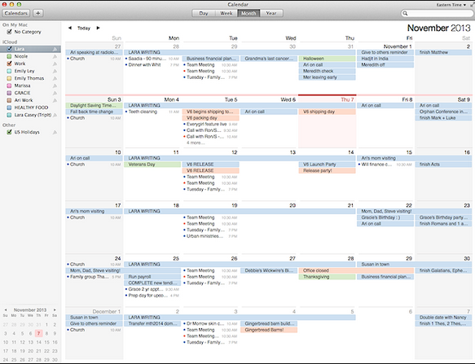
Calendar
  (broken bit)
  List of events
  Calendar formats
    - .ical

Slide 35
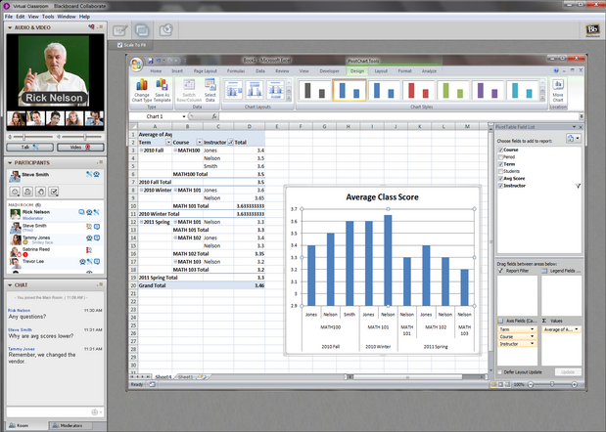
Events
  - BB Collaborate
    Recordings / URL + Player (Java)
  Others – Webx, Wiziq, Adobe Connect
  Webcasting =
    Conferencing tool (any of above or Skype) +
    Webcasting tool – YouTube, LiveStream, Ustream
  Recordings

Slide 36
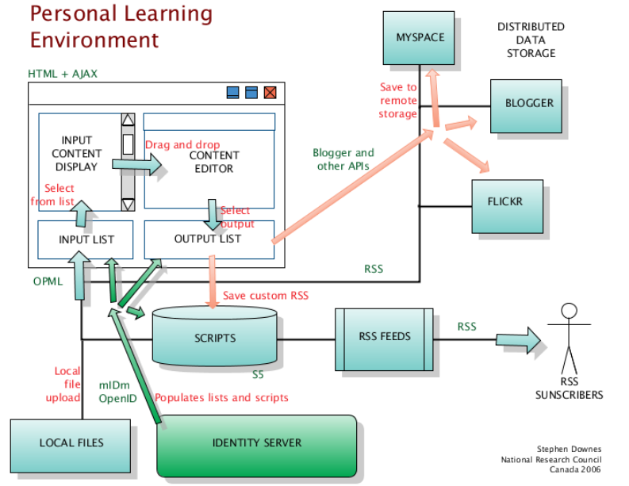
How to Build A Learning Network

Slide 37
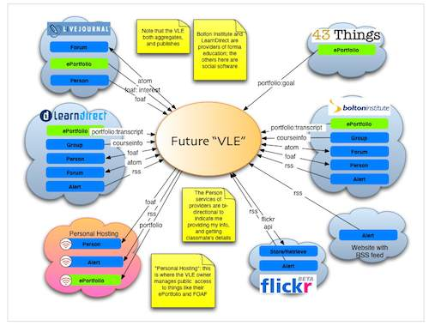
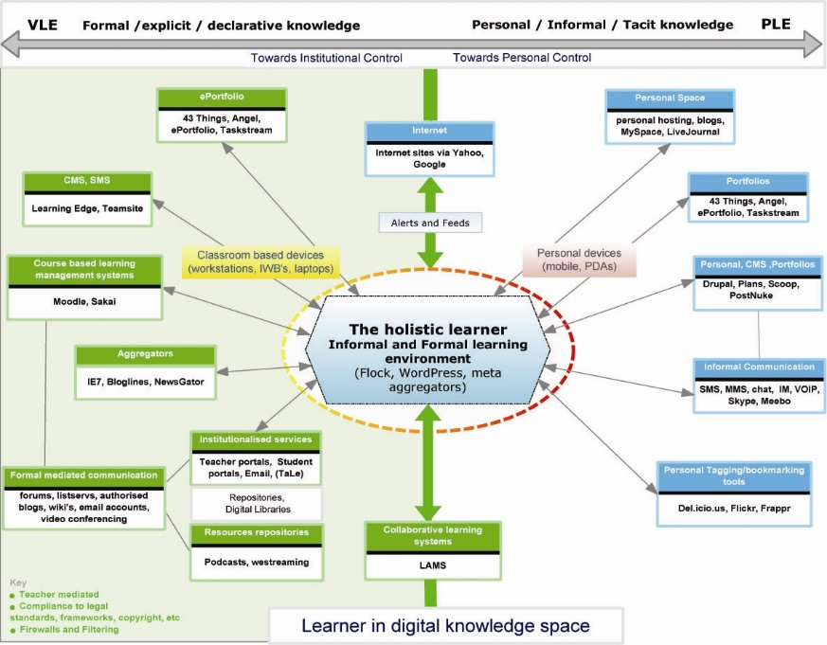
The design is based on putting the learner at the center
Scott Wilson (left), Tim Hand (right)
https://www.google.com/search?q=ple+diagrams
http://www.edtechpost.ca/ple_diagrams/index.php/mind-map-3

Slide 38
LPSS Core Projects

Slide 39
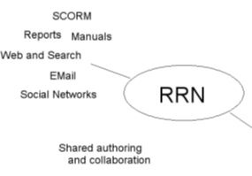
Resource Repository Network
Manage and discover list of sources and resources
Maintain authentication and credentials
Support APIs and metadata standards
Gather, analyze and sort resources and/or metadata

Slide 40
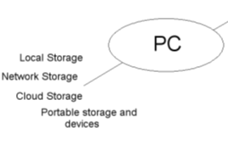
Personal Cloud
Manage list of local and remote storage systems
Maintain security, encryption, authentication and credentials
Include local or personal device storage
Manage and synchronize resource sets and data

Slide 41
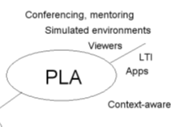
Personal Learning Assistant
Collect contextual information for system
Display resources of various formats, inclusing SCORM, LTI, etc.
Support (scaffolded) authoring environments
Project LPSS capacity into external software and devices

Slide 42
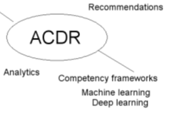
Competency Recognition and Development
Import or create competency definitions
Analyze interactions for skills and learning gaps
Support development of learning plans
Provide resource and service recommendations

Slide 43

Personal Learning Record
Collect full record of interactions with all resources, external systems
Support learning activity data exchange formats (eg. xAPI)
Collect and present a person’s personal portfolio
Display certifications and credentials (eg. badges)
Maintain 3rd party certification

Slide 44
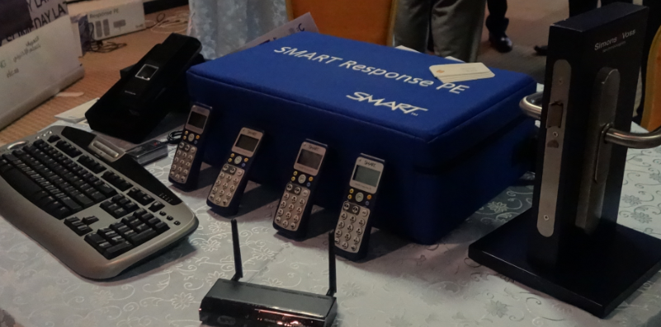
Implementation – from MOOC to Personal Learning
MOOC-REL (OIF)
ALECSO
MINT
SHARE
Badges
Simulator
Workplace T&D

Slide 45
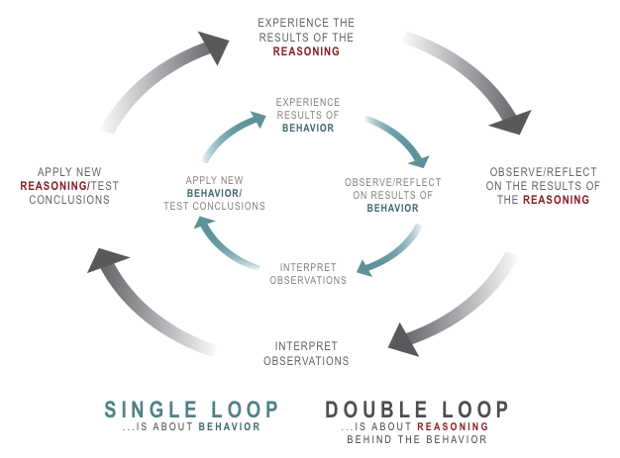
Implementation Projects
Ultimately, the objective is to support individual learning in a network
http://integralleadershipmanifesto.com/manifesto/making-subject-object/

Slide 46
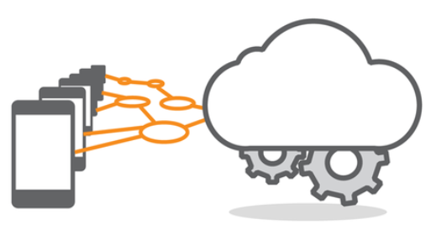
Corporate / institutional clouds
  xMOOCs
  Content libraries
  OAI

Slide 47

3rd party services
  Recommender / indices / translation
  Simulations / multiplayer games
  IoT
Logo for the MOOC "Your World is Your Lab." Credit: Michael Schatz

Slide 48
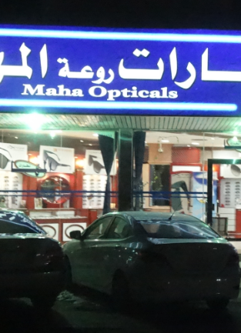
Why is this important?
Because technology is not just a tool
It gives us the capacity to do new things (the ‘affordances argument’)
It represents an extension of our perceptions (the McLuhan argument)
“We shape technology, and then technology shapes us”

Slide 49
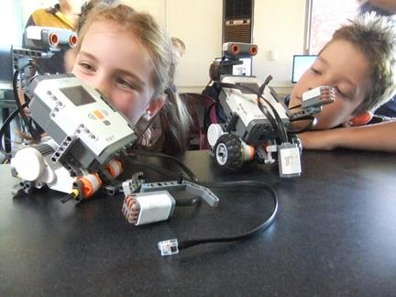
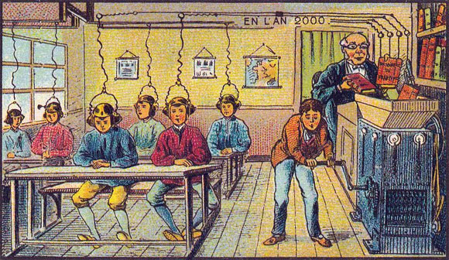

What kind of learner we become depends on what kind of learning technology we choose
http://singularityhub.com/2012/10/15/19th-century-french-artists-predicted-the-world-of-the-future-in-this-series-of-postcards/
http://www.alter-inc.com/wearable.html
http://www.keithcotps.sa.edu.au/Learning.htm

Slide 50
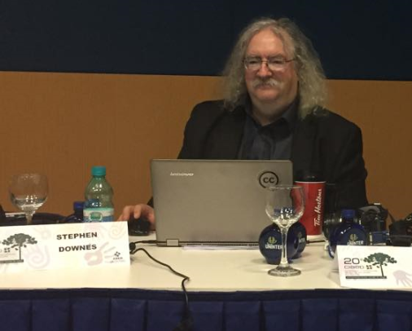
Stephen Downes
http://www.downes.ca

